Slide 1
What is Docker?
Docker is a configuration management tool that is used to automate the deployment of software in lightweight containers. These containers help applications to work efficiently in different environments.
Docker container is a software package that has all the dependencies required to run an application.
Note: A Docker Image is a template of instructions used to create containers.

Slide 2
What is a Dockerfile?
Docker Image:
A Docker Image is a read-only file with a bunch of instructions. When these instructions are executed, it creates a Docker container.
Dockerfile:
Dockerfile is a simple text file that consists of instructions to build Docker images.

Slide 3
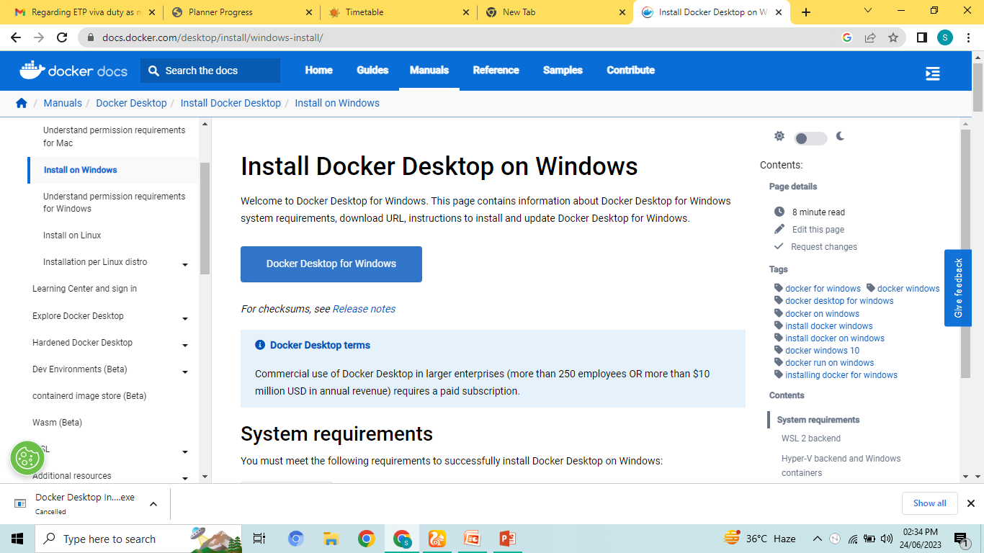
Docker Desktop
Go to Googlr chrome:-
Download: Docker Desktop Installer.exe

Slide 4
Thinks to be noted
System’s compatibility
Docker Desktop runs on windows version 10 or above 10.
Virtualization is enabled.
Virtualization is enabled by rebooting your system.

Slide 5
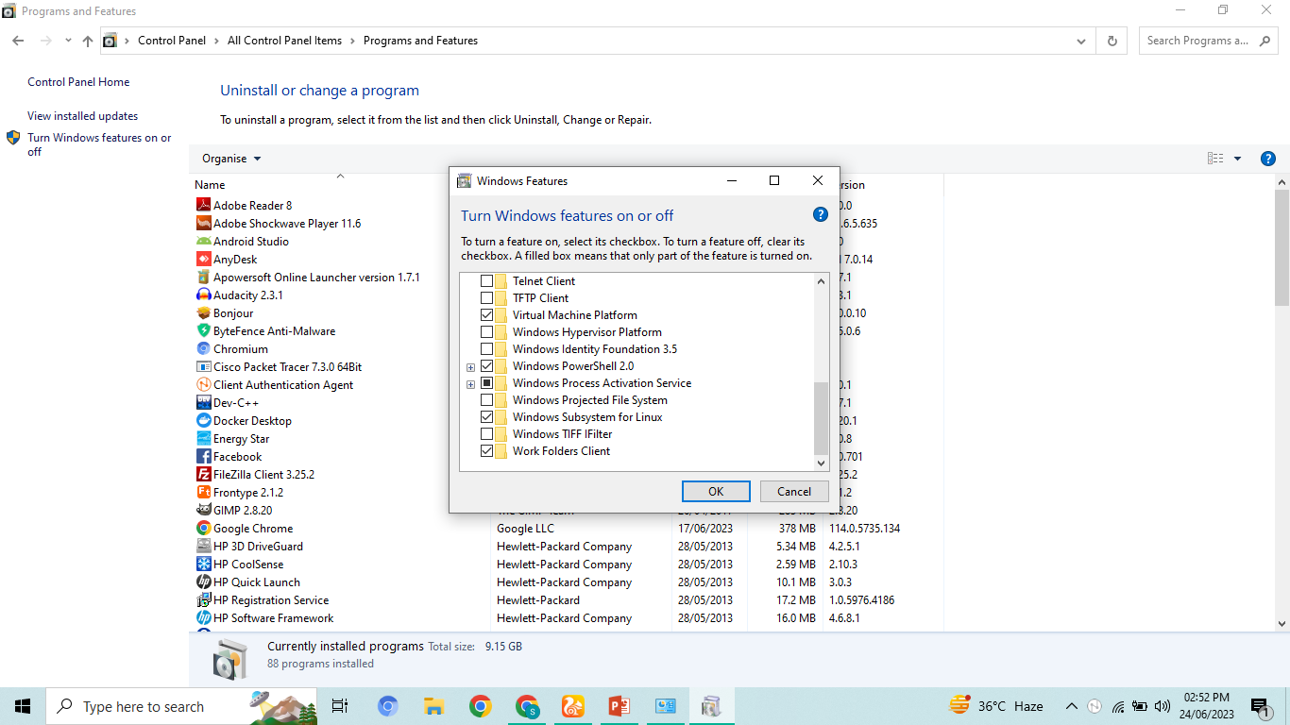
Docker Steps on Windows:
Open Control Panel.
Open Programs and Features.
Click on Turn Windows features on or off.
Select windows sub system for Linux
At last click on restart system.

Slide 6
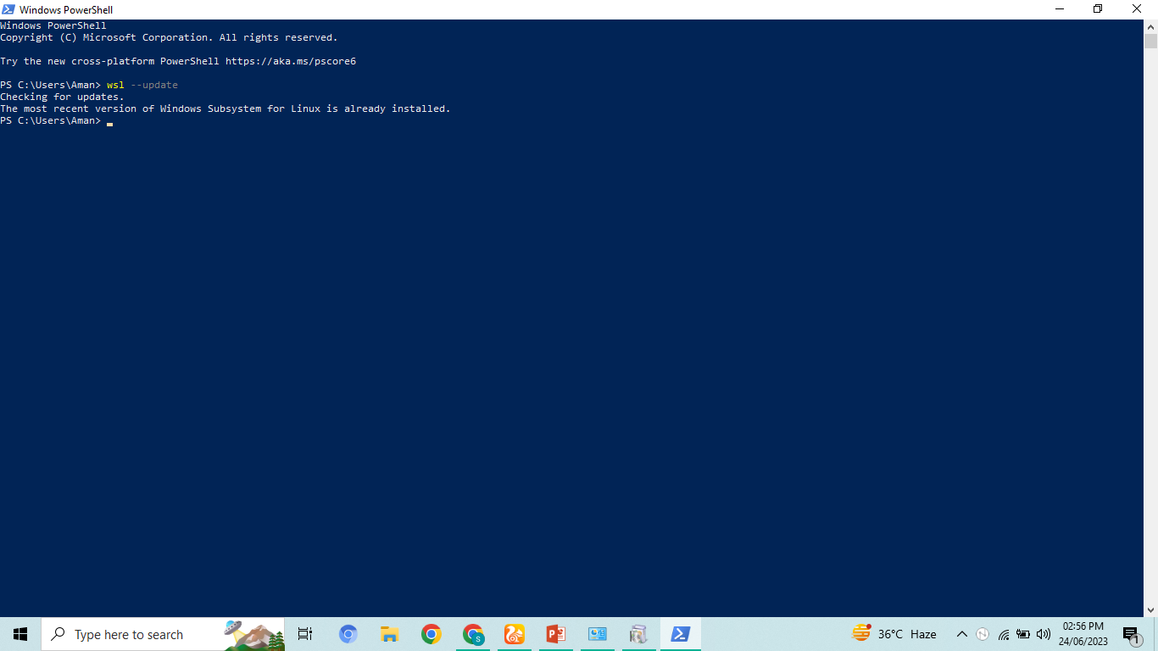
Continue:
Go to windows Power Shell and type
wsl --update

Slide 7
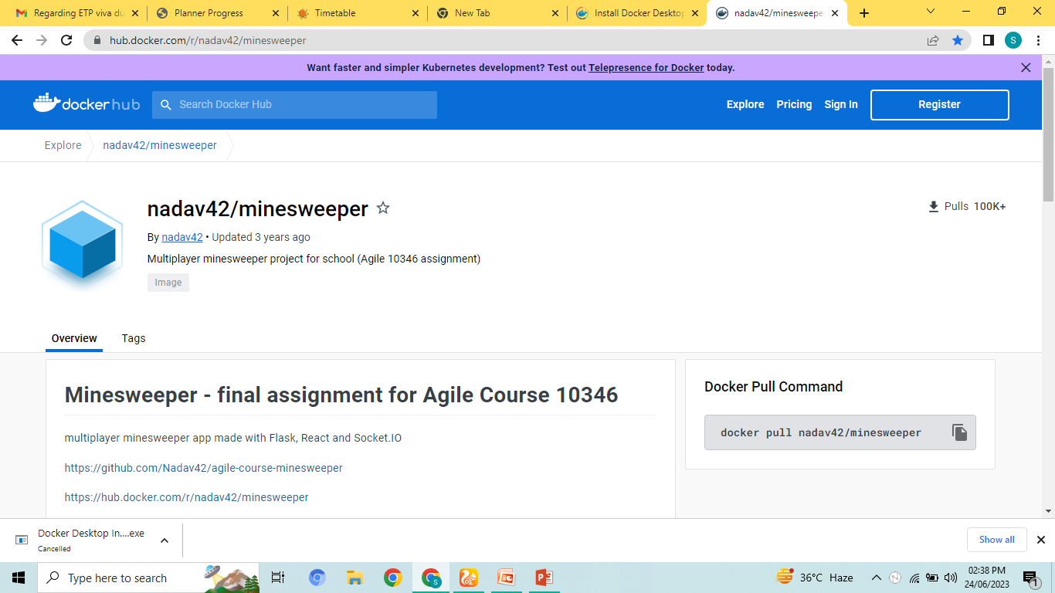
Working with Docker Containers:
Search from Google Chrome:
HUB.docker.com/r/nadav42/minesweeper

Slide 8
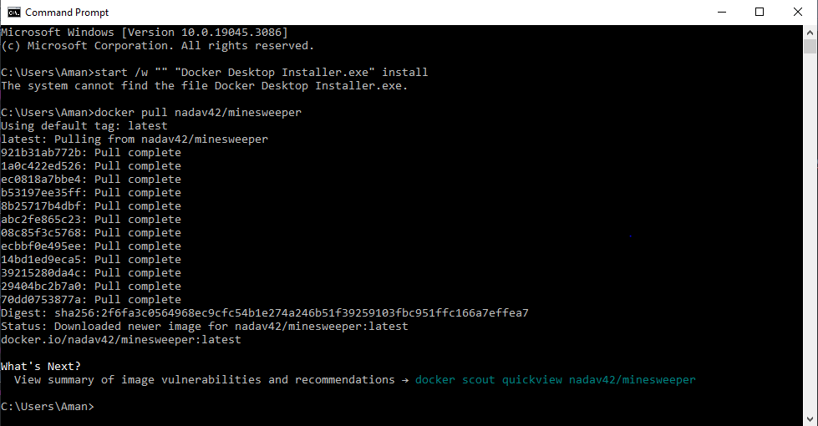
Docker Pull Command
Copy “docker pull nadav42/minesweeper” from Docker Hub and paste it on command prompt.

Slide 9
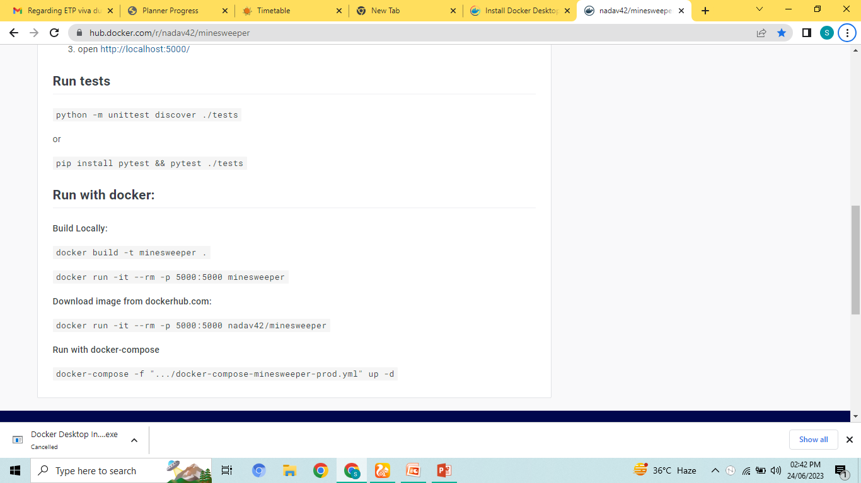
Continue:
Then go to Run with Docker and copied the below mentioned commands.
Build Locally:
docker build -t minesweeper
Download image from dockerhub.com:
docker run -it --rm -p 5000:5000 nadav42/minesweeper

Slide 10
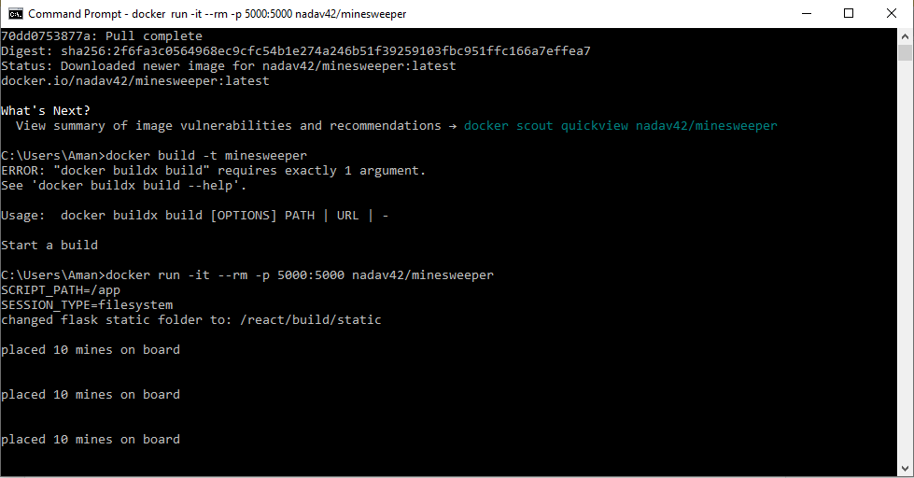
Continue :
Paste these commands on command prompt
After running build and download Docker image.

Slide 11
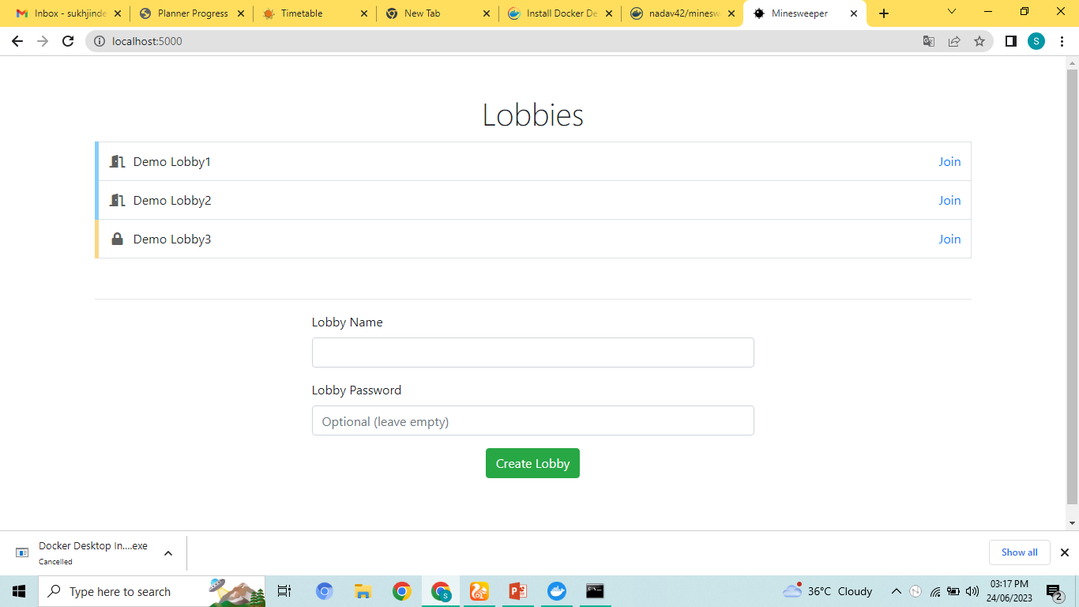
Results:
Go to chrome and then type
Localhost:5000 in search bar.

Slide 12
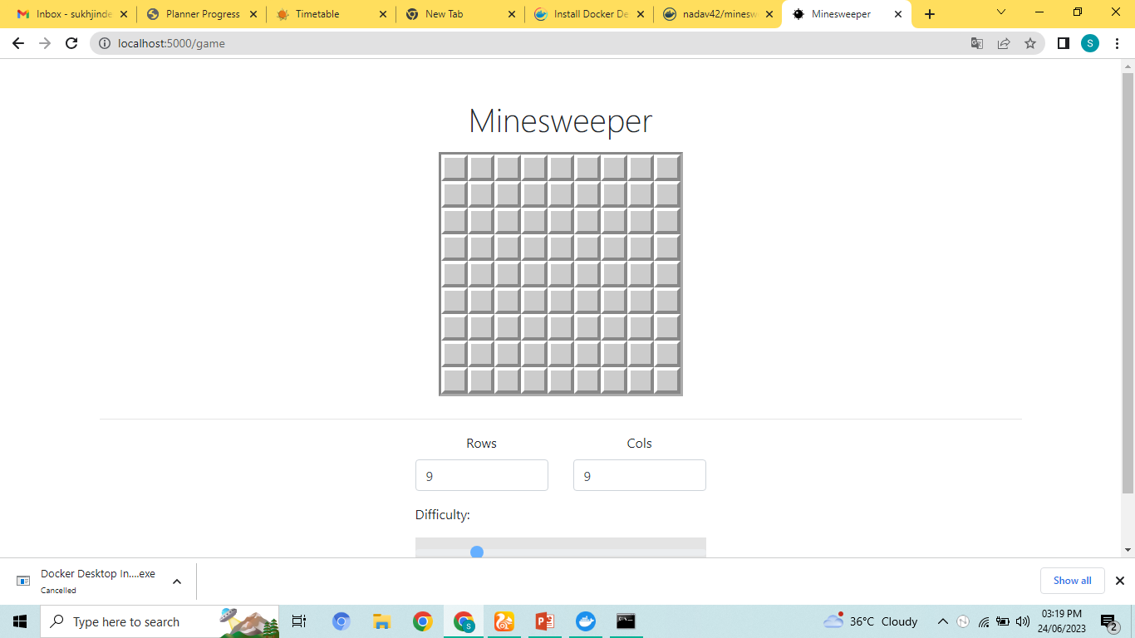
Result of Minesweeper game on localhost:

Slide 13
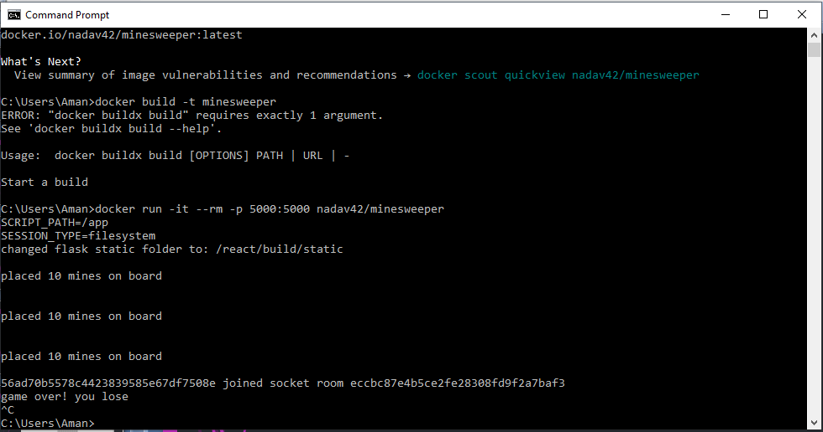
Stop the game:
Type ctrl+c on command prompt.

Slide 14
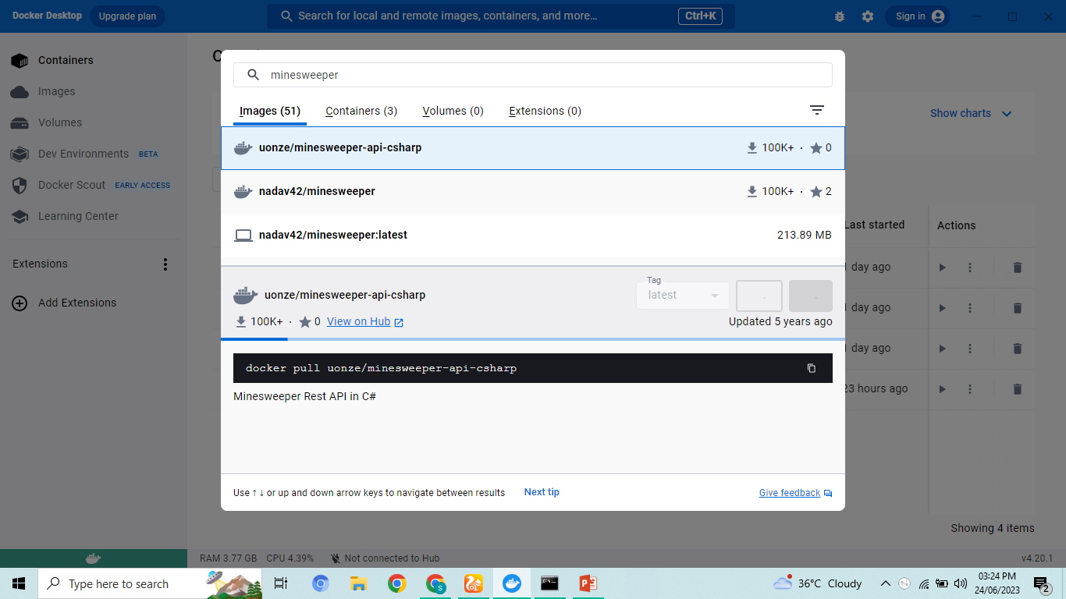
Working on Docker Desktop:
Search on Docker’s Desktop: Minessweeper.

Slide 15
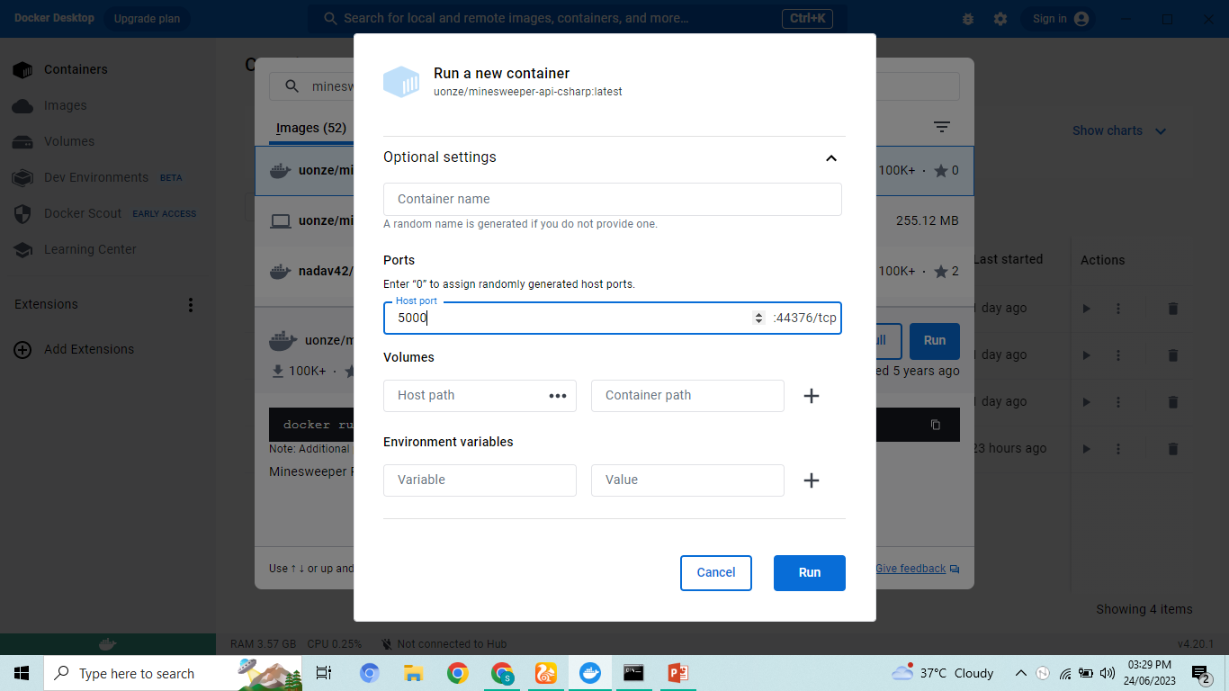
Continue:
Click on Run and in optional settings, type host port i.e. 5000.

Slide 16
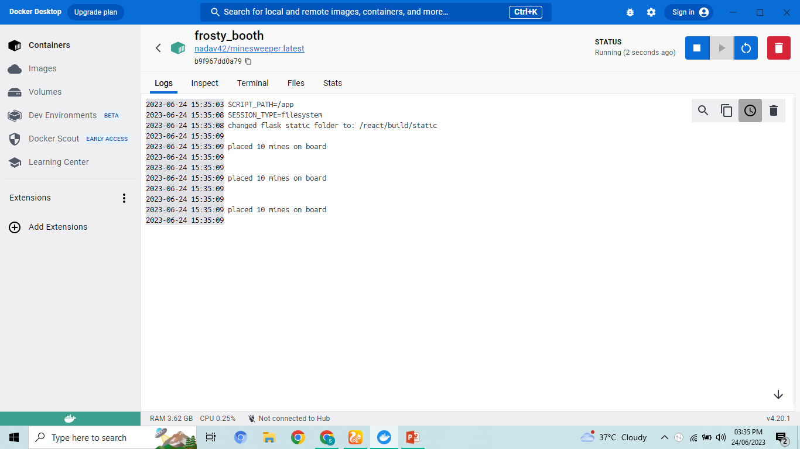
Results:
Shown on Docker Desktop.

Slide 17
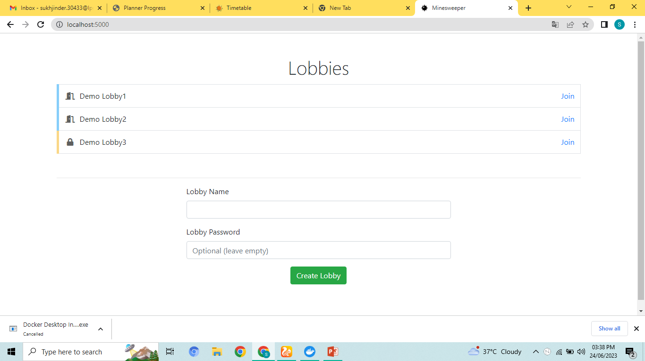
Result of Minesweeper game
on localhost:5000

Slide 18
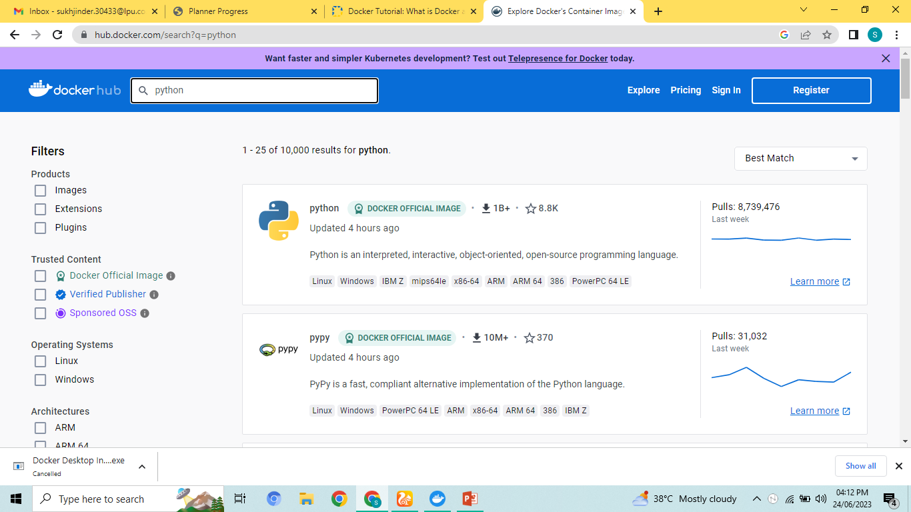
Docker Hub:
Go to docker hub official site and search for Python Image.

Slide 19
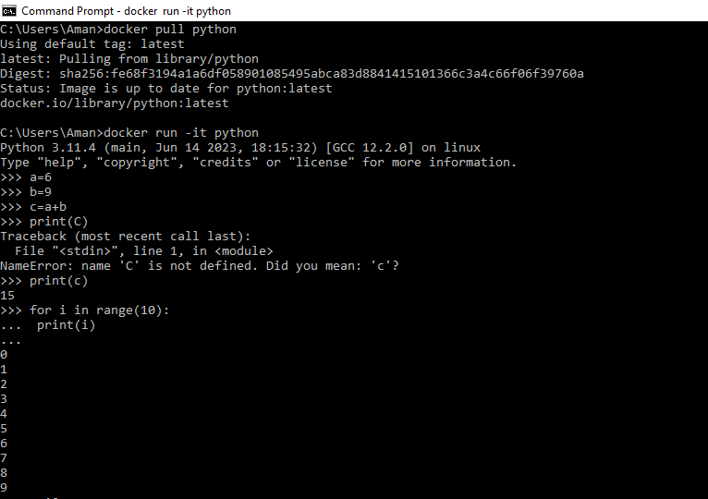
Continue:
Copy the command “Docker pull python” and Docker run –it python from docker hub and run it on command prompt.

Slide 20
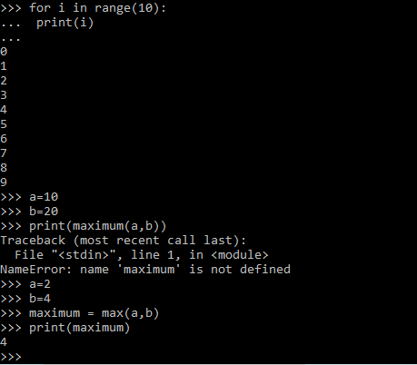

Slide 21
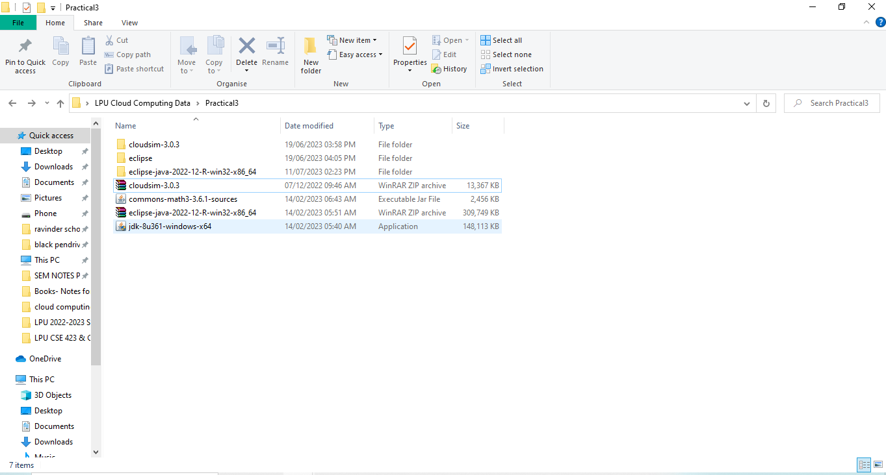
CloudSim
Extract CloudSim 3.0.3
Install Eclipse IDE
Install JDK

Slide 22
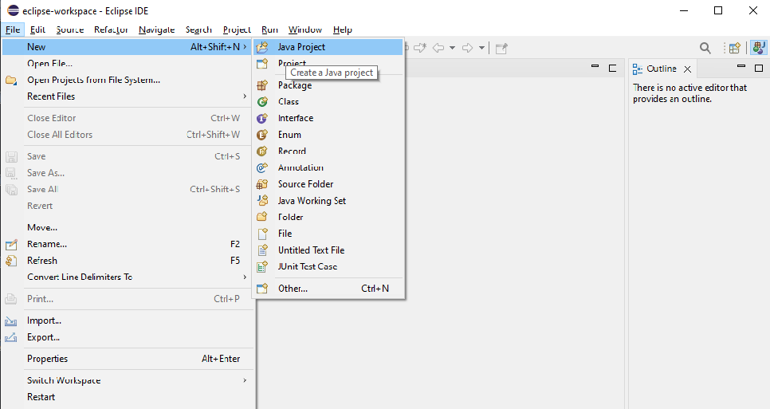
Launch Cloudsim
Open Eclipse IDE
File
New
Java Project

Slide 23
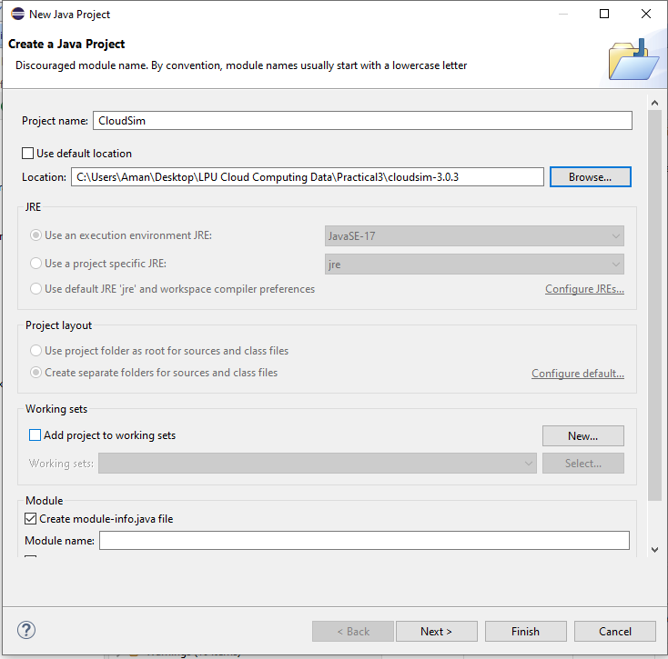
Continue:
4. Project Name: Cloudsim
Use Default Location (choose untick )
5. Go to browse and add CloudSim 3.0.3
6. Next

Slide 24
Continue
7. Libraries
8. Add External Jars
9. Select Common maths
10. Finish

